Slide 1

Route Optimization
Presented By
Annan He
Vince Carter
Will Peltier
Raghavendra Pariti
Akshaj Khirwadkar

Slide 2

Project Overview
The Main Objective of this project is the optimization of Direct Store Delivery (DSD) routes, addressing the following key points:
Sales Maximization: Increase store service visits from 3 to 5 times a week, aiming to boost sales by 5% with each additional visit, as hypothesized.
Operational Challenge: Optimize DSD routes to improve delivery efficiency.
Cost Minimization: Reduce operational costs, including time/labor and distance/fuel expenses, associated with these deliveries.
Strategy: Evaluate two DSD routes to identify potential efficiencies and optimizations, considering both individual and crossover opportunities.
Our goal is to bolster Rudi's market presence and support its mission of delivering nutritious and delicious bread to a broader customer base.

Slide 3
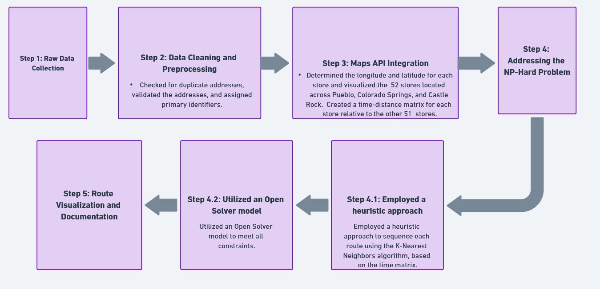
Approach Taken

Slide 4

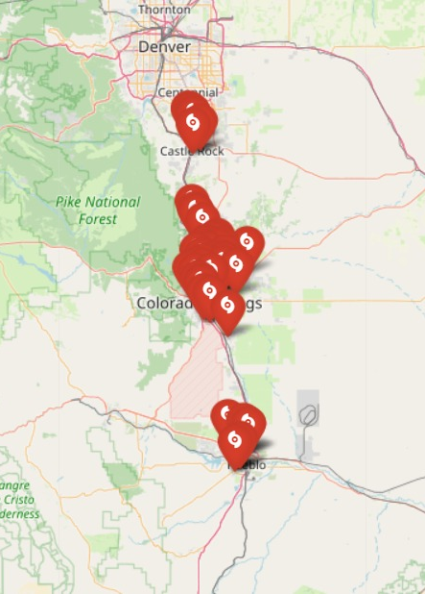
Data Overview
To build our optimization model in Open Solver, we needed to address various stages of data processing.
Raw Data Analysis
Validating Addresses using Validation API
Fetching Geographical Coordinates (Latitudes, Longitudes) using GeoPandas
Visualizing store locations using Leaf Map Library
Generating Distance-Time Matrix using Distance-Matrix API
Implementing K Nearest Neighbors Algorithm to segregate all the 52 stores
Executing these steps laid a foundation to approach our optimization model.

Slide 5
Modelling Approach
mTSP – Multiple Travelling Salesman Problem.
NP hard -
Combinatorial Nature
Complexity with Constraints
Decision Variables
Approach Taken
K-nearest neighbour heuristic
MILP (Mixed Integer Linear Programming) Approach

Slide 6
Heuristic Approach using KNN
Implementation of Nearest Neighbor Heuristic
Routing Logic and Sequential Assignment:
Balanced Distribution Through a Toggle Mechanism
Minimized Travel Distance for Operational Efficiency:
Foundation for Further Optimization:

Slide 7
Mixed Integer Linear Programming
The MILP framework is employed due to its robustness in handling the linear relationships between the decision variables and the objective, while efficiently incorporating the integer constraints that define the delivery decisions.
Objective Function
To maximize the total number of deliveries within an operational week using 2 vehicles.
Decision Variables
The deliveries to each store for the period of 5 operational days.
Constraints
Daily Delivery Requirement for Costco
Minimum Weekly Delivery Frequency
Distribution of Delivery Days
One Delivery per Store per Operational Day
Daily Working Hours Cap
Sequence Constraint
Entry and Exit Equality Constraint
Diagonal Entries Constraint

Slide 8
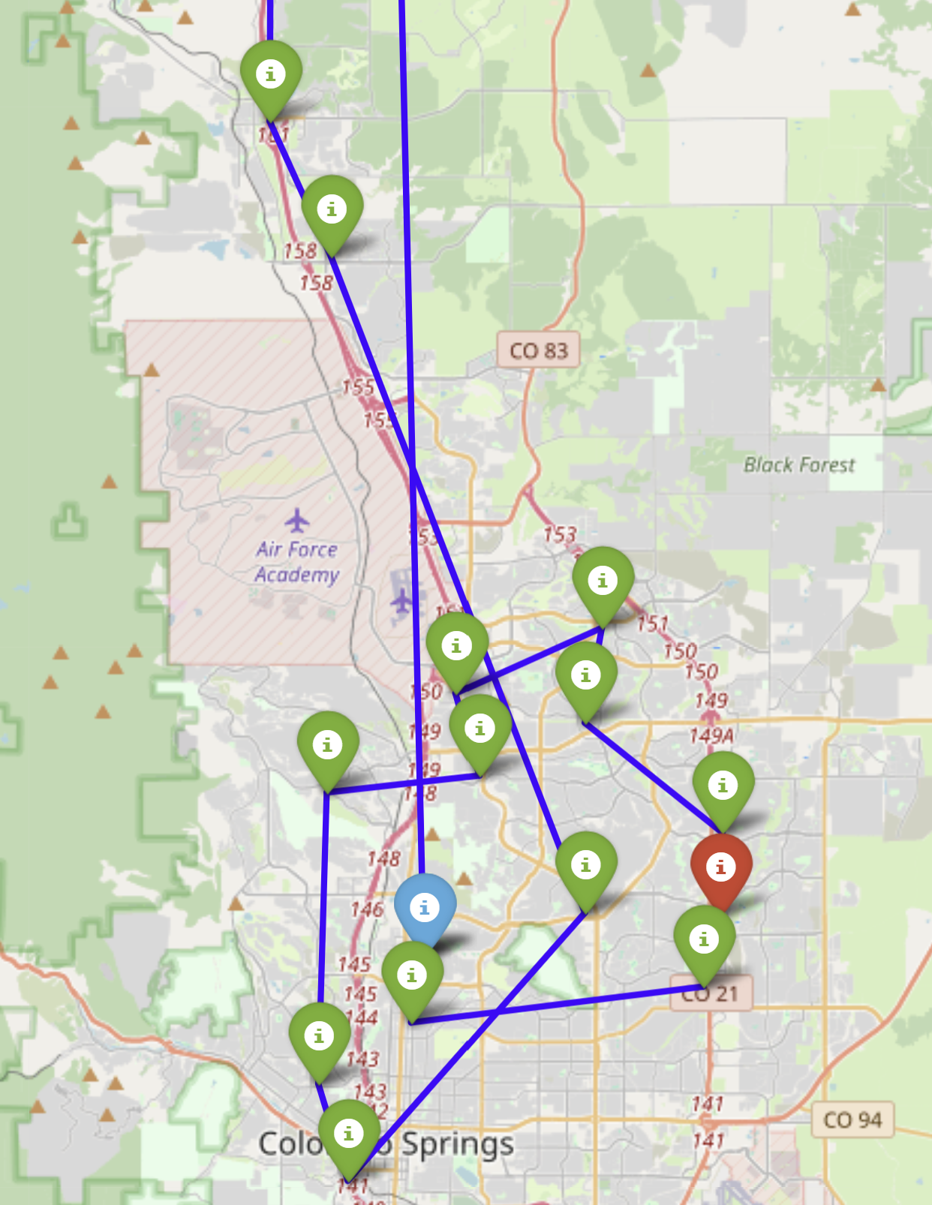
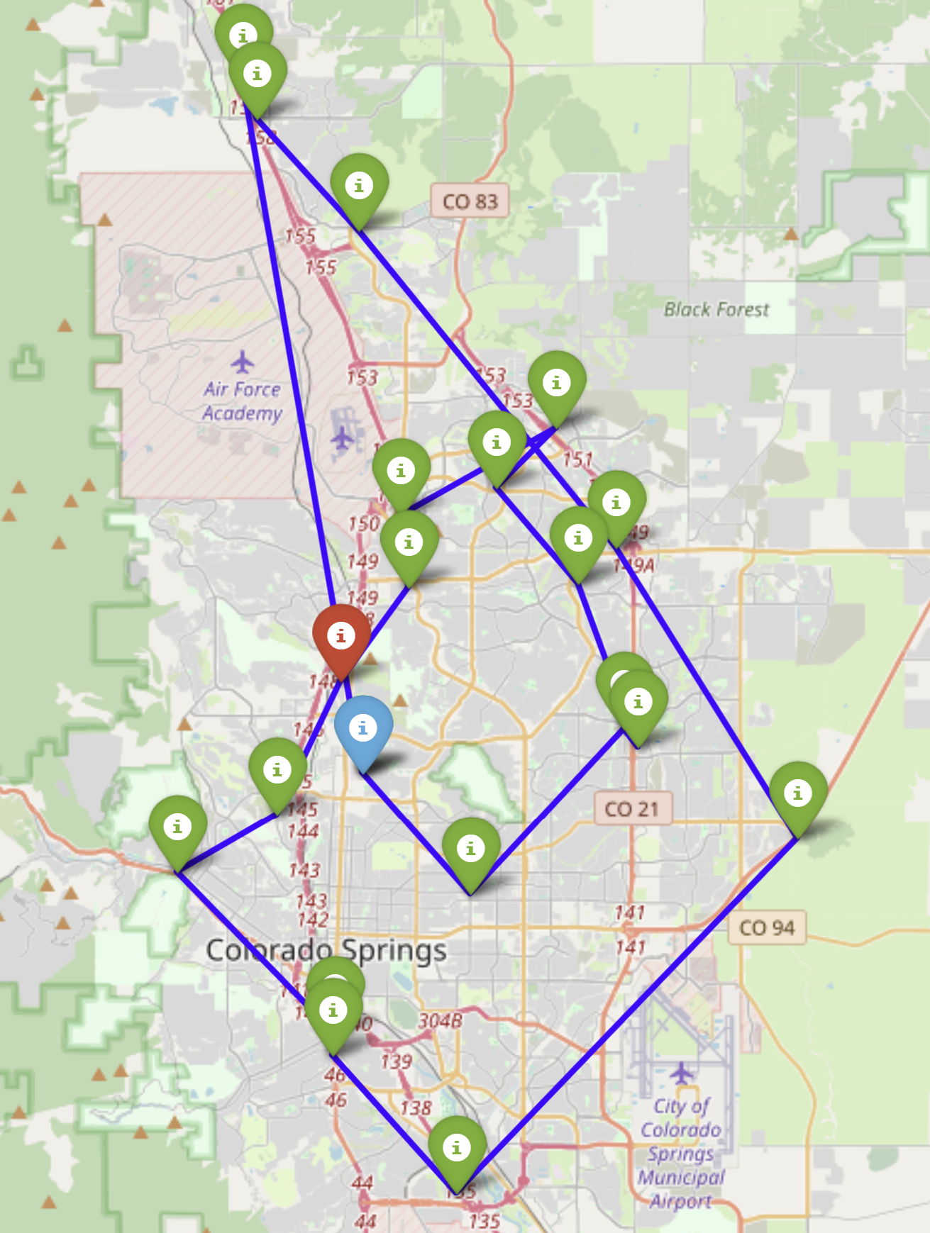
Route Output Example for Monday
Vehicle 1
Vehicle 2

Slide 9
Summary Stats
Parameter | Original Schedule | Optimized Schedule
Weekly Deliveries | 113 | 192
Store Delivery Frequency | 33 stores fewer than 3x a week | All stores at least 3x a week
Deliveries to Specific Store | 10 stores only once a week | Costco's 5x a week
Average Route Time | Not specified | 8.6 hours

Slide 10
Future Directions
Sales:
The second part of the project, including sales data, was not something that we got around to. Our model is capable of incorporating the sales data, but we just didn’t have enough time to do it well.
Frontend:
While we did provide a strong model for route optimization, we did not have the time to provide an easy-to-use frontend for the model.
Greater Area of Service:
Another avenue to continue would be to handle an area bigger than the one given, whether that be more stores, or just a greater geographical area.
More Constraints:
The client mentioned many things in our meetings that could be micro adjusted to improve our model even further.

